Slide 1
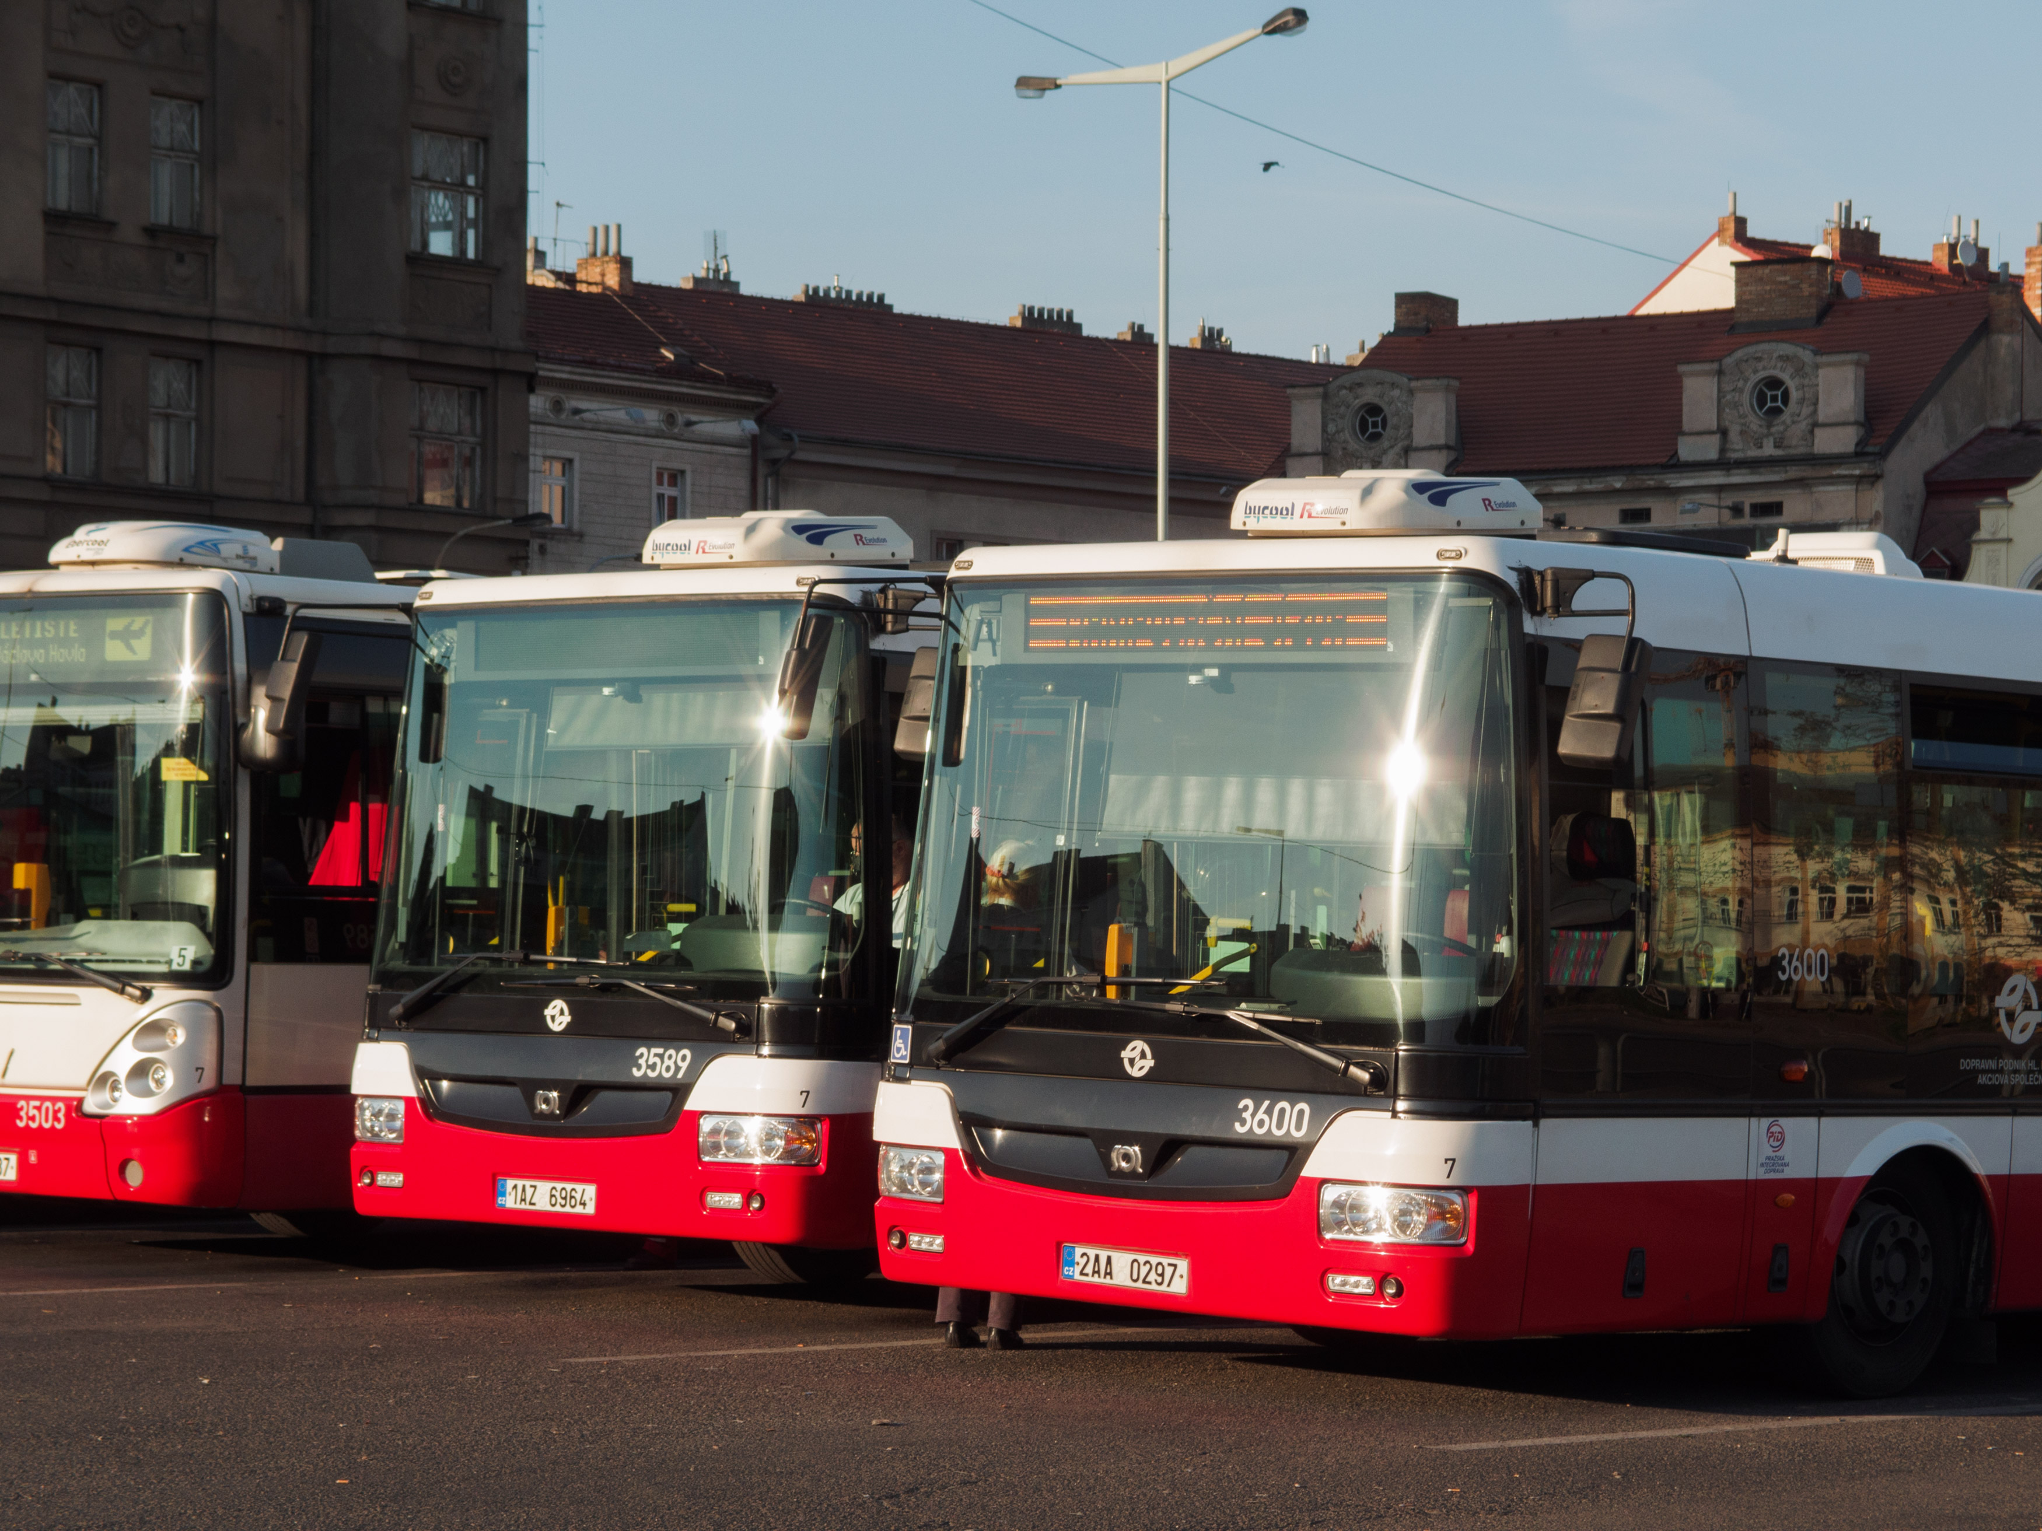
Bus Ticketing & Management System

Slide 2
Introduction
Every day, millions of individuals buy bus tickets to get to their destinations, such as the office, school, college, shopping malls, and hospitals. The enormous number of incoming inquiries requires a significant amount of time to review and confirm over the phone. Buying and reserving bus tickets allows you to fully automate the bus ticket booking process and handle hundreds of transactions each day. Automation allows you to progressively cut customer support expenses by simply adjusting technical components to deliver tickets to consumers. This Bus Ticket Booking System is a simple to use, integrated end-to-end system that starts with bus route finding and ends with bus booking. No formal knowledge is needed for the user to use this system. It also provides error message while entering invalid data. Thus, by this all it proves it is user-friendly.

Slide 3
Objectives
Automation of Bus Ticketing Process.
Digital Transformation.
Health and Safety Considerations.
Administrator Control and Security.
Continuous Improvement and Adaptability.

Slide 4
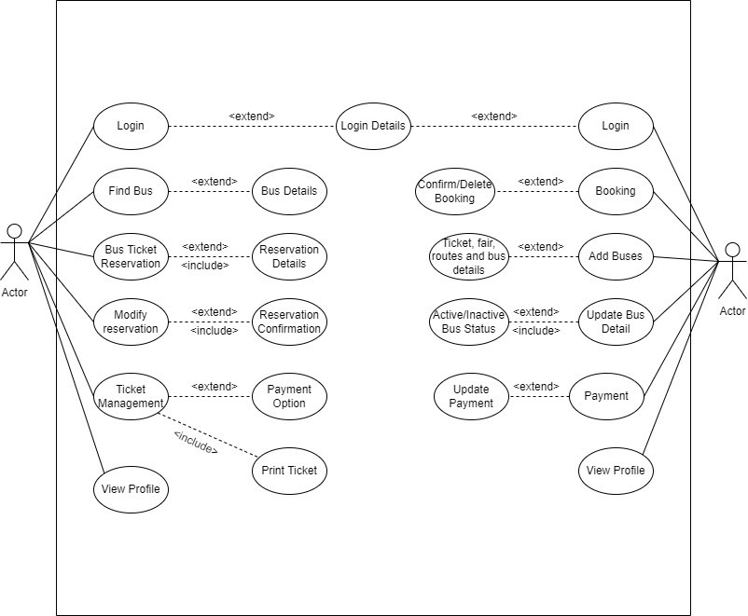
Proposed system

Slide 5
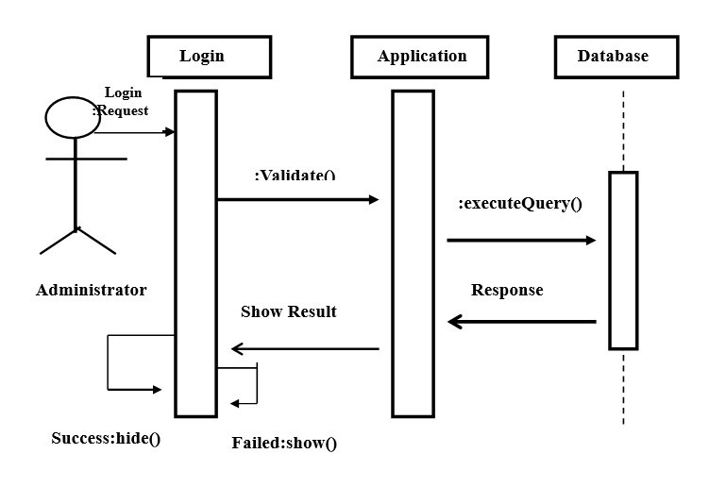
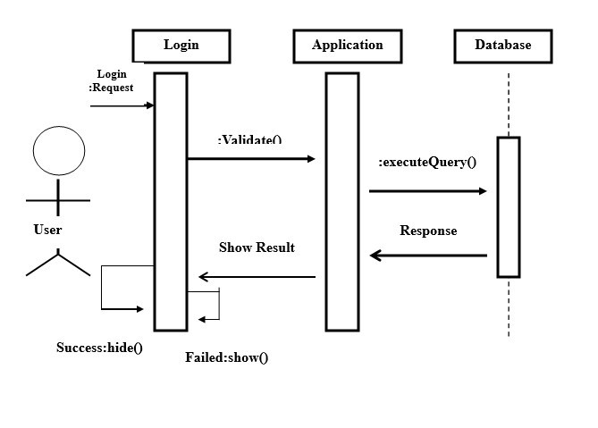

Slide 6
Conclusion
In conclusion, the proposed digital transformation of the current manual bus ticketing system presents a strategic and timely solution to the challenges faced by both the service providers and customers. By using online platforms, mobile applications, and self-service stand, we aim to streamline the ticketing process, boost availability, and align with the evolving(developing) expectations of a modern, tech-savvy (a person who loves or is enthusiastic about advanced technology) society.

Slide 7
Thank you

